Slide 1
Search and Sequential Action
CHAPTER 3
CMPT 310 - Blind Search

Slide 2
Outline
Problem formulation: representing sequential problems.
Example problems.
Planning for solving sequential problems without uncertainty.
Basic search algorithms
CMPT 310 - Blind Search

Slide 3
Environment Type Discussed In this Lecture
Fully Observable
Static Environment
yes
Deterministic
yes
Sequential
yes
no
Discrete
no
yes
Discrete
no
yes
Planning, heuristic search
Control, cybernetics
Vector Search: Constraint Satisfaction
Continuous Function Optimization
CMPT 310 - Blind Search

Slide 4
Choice in a Deterministic Known Environment
Without uncertainty, choice is trivial in principle: choose what you know to be the best option.
Trivial if the problem is represented in a look-up table.
Option | Value
Chocolate | 10
Wine | 20
Book | 15
This is the standard problem representation in decision theory (economics).
CMPT 310 - Blind Search

Slide 5
Computational Choice Under Certainty
But choice can be computationally hard if the problem information is represented differently.
Options may be structured and the best option needs to be constructed.
  E.g., an option may consist of a path, sequence of actions, plan, or strategy.
The value of options may be given implicitly rather than explicitly.
  E.g., cost of paths need to be computed from map.
CMPT 310 - Blind Search

Slide 6

Sequential Action Example
Deterministic, fully observable → single-state problem
  Agent knows exactly which state it will be in; solution is a sequence
  Romania → The full map is observed
Single-state: Start in #5. Solution??
  [Right, Suck]
  Vacuum world → everything observed
CMPT 310 - Blind Search

Slide 7
Problem types
Non-observable → sensorless problem (conformant problem)
  Agent may have no idea where it is; solution is a sequence
  Romania → No map just know operators(cities you can move to)
Conformant: Start in {1, 2, 3, 4, 5, 6, 7, 8}
  e.g., Right goes to {2, 4, 6, 8}. Solution??
  [Right, Suck,Left, Suck]
  Vacuum world → No sensors
CMPT 310 - Blind Search

Slide 8
Problem types
Nondeterministic and/or partially observable → contingency problem
  percepts provide new information about current state
  Unknown state space → exploration problem
  Vacuum world → know state of current location
  Romania → know current location and neighbor cities
Contingency: [L,clean]
  Start in #5 or #7
  Murphy’s Law: Suck can dirty a clean carpet
  Local sensing: dirt, location only.
  Solution??
  [Right, if dirt then Suck]
CMPT 310 - Blind Search

Slide 9
Example: Romania
On holiday in Romania; currently in Arad.
Flight leaves tomorrow from Bucharest
Formulate goal:
  be in Bucharest
Formulate problem:
  states: various cities
  actions: drive between cities
Find solution:
  sequence of cities, e.g., Arad, Sibiu, Fagaras, Bucharest
CMPT 310 - Blind Search

Slide 10

Example: Romania
Abstraction: The process of removing details from a representation
Is the map a good representation of the problem? What is a good replacement?
CMPT 310 - Blind Search

Slide 11
Single-state problem formulation
A problem is defined by four items:
initial state e.g., "at Arad“
actions or successor function S(x) = set of action–state pairs
  e.g., S(Arad) = {<Arad → Zerind, Zerind>, … }
goal test, can be
  explicit, e.g., x = "at Bucharest"
  implicit, e.g., Checkmate(x)
path cost (additive)
  e.g., sum of distances, number of actions executed, etc.
  c(x,a,y) is the step cost, assumed to be ≥ 0
A solution is
  a sequence of actions leading from the initial state to a goal state
CMPT 310 - Blind Search

Slide 12
Selecting a state space
Real world is complex
  → state space must be abstracted for problem solving
(Abstract) state = set of real states
(Abstract) action = complex combination of real actions
  e.g., "Arad → Zerind" represents a complex set of possible routes, detours, rest stops, etc.
(Abstract) solution =
  set of real paths that are solutions in the real world
Each abstract action should be "easier" than the original problem
CMPT 310 - Blind Search

Slide 13

Vacuum world state space graph
states?
actions?
goal test?
path cost?
CMPT 310 - Blind Search

Slide 14
Vacuum world state space graph
states? integer dirt and robot location
actions? Left, Right, Suck
goal test? no dirt at all locations
path cost? 1 per action
CMPT 310 - Blind Search

Slide 15

Example: The 8-puzzle
states?
actions?
goal test?
path cost?
CMPT 310 - Blind Search

Slide 16
Example: The 8-puzzle
states? locations of tiles
actions? move blank left, right, up, down
goal test? = goal state (given)
path cost? 1 per move
[Note: optimal solution of n-Puzzle family is NP-hard]
CMPT 310 - Blind Search

Slide 17

Example: robotic assembly
states?:
  real-valued coordinates of robot joint angles parts of the object to be assembled
actions?:
  continuous motions of robot joints
goal test?:
  complete assembly
path cost?:
  time to execute
CMPT 310 - Blind Search

Slide 18
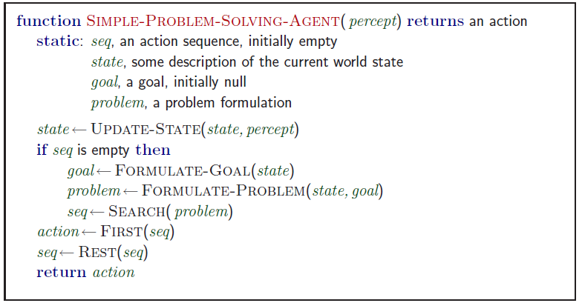
Problem-solving agents
Note: this is offline problem solving; solution executed “eyes closed.”
CMPT 310 - Blind Search

Slide 19

Tree search algorithms
Basic idea:
  offline, simulated exploration of state space by generating successors of already-explored states (a.k.a.~expanding states)
CMPT 310 - Blind Search

Slide 20

Tree search example
CMPT 310 - Blind Search

Slide 21

Tree search example
CMPT 310 - Blind Search

Slide 22

Tree search example
CMPT 310 - Blind Search

Slide 23
Search Graph vs. State Graph
Be careful to distinguish
  Search tree: nodes are sequences of actions.
  State Graph: Nodes are states of the environment.
  We will also consider soon search graphs.
Demo: http://aispace.org/search/
CMPT 310 - Blind Search
Notes:
Under full observability, no big distinction between state of agent and state of the world.
Do Demo, while also drawing search tree.

Slide 24
Search strategies
A search strategy is defined by picking the order of node expansion
Strategies are evaluated along the following dimensions:
  completeness: does it always find a solution if one exists?
  time complexity: number of nodes generated
  space complexity: maximum number of nodes in memory
  optimality: does it always find a least-cost solution?
Time and space complexity are measured in terms of
  b: maximum branching factor of the search tree
  d: depth of the least-cost solution
  m: maximum depth of the state space (may be ∞)
CMPT 310 - Blind Search
Notes:
Very popular, basically graph theory

Slide 25
Uninformed search strategies
Uninformed search strategies use only the information available in the problem definition
Breadth-first search
Depth-first search
Depth-limited search
Iterative deepening search
CMPT 310 - Blind Search

Slide 26

Breadth-first search
Expand shallowest unexpanded node
Implementation:
  Frontier or fringe is a FIFO queue, i.e., new successors go at end
CMPT 310 - Blind Search

Slide 27

Breadth-first search
Expand shallowest unexpanded node
Implementation:
  frontier is a FIFO queue, i.e., new successors go at end
CMPT 310 - Blind Search

Slide 28

Breadth-first search
Expand shallowest unexpanded node
Implementation:
  frontier is a FIFO queue, i.e., new successors go at end
CMPT 310 - Blind Search

Slide 29

Breadth-first search
Expand shallowest unexpanded nodehttp://aispace.org/search/
Implementation:
  frontier is a FIFO queue, i.e., new successors go at end
CMPT 310 - Blind Search

Slide 30
Properties of breadth-first search
Complete? Time? Space?Optimal?
Complete? Yes (if b is finite)
Time? 1+b+b²+b³+… +b^{d} + b(b^{d}-1) = O(b^{d+1})
Space? O(b^{d+1}) (keeps every node in memory)
Optimal? Yes (if cost = 1 per step)
Space is the bigger problem (more than time)
CMPT 310 - Blind Search
Notes:
We skip for now, come back later.

Slide 31

Depth-first search
Expand deepest unexpanded node
Implementation:
  frontier = LIFO queue, i.e., put successors at front
CMPT 310 - Blind Search

Slide 32

Depth-first search
Expand deepest unexpanded node
Implementation:
  frontier = LIFO queue, i.e., put successors at front
CMPT 310 - Blind Search

Slide 33

Depth-first search
Expand deepest unexpanded node
Implementation:
  frontier = LIFO queue, i.e., put successors at front
CMPT 310 - Blind Search

Slide 34

Depth-first search
Expand deepest unexpanded node
Implementation:
  frontier = LIFO queue, i.e., put successors at front
CMPT 310 - Blind Search

Slide 35

Depth-first search
Expand deepest unexpanded node
Implementation:
  frontier = LIFO queue, i.e., put successors at front
CMPT 310 - Blind Search

Slide 36

Depth-first search
Expand deepest unexpanded node
Implementation:
  frontier = LIFO queue, i.e., put successors at front
CMPT 310 - Blind Search

Slide 37

Depth-first search
Expand deepest unexpanded node
Implementation:
  frontier = LIFO queue, i.e., put successors at front
CMPT 310 - Blind Search

Slide 38

Depth-first search
Expand deepest unexpanded node
Implementation:
  frontier = LIFO queue, i.e., put successors at front
CMPT 310 - Blind Search

Slide 39

Depth-first search
Expand deepest unexpanded node
Implementation:
  frontier = LIFO queue, i.e., put successors at front
CMPT 310 - Blind Search
Notes:
Beautifil connection to queue concepts

Slide 40

Depth-first search
Expand deepest unexpanded node
Implementation:
  frontier = LIFO queue, i.e., put successors at front
CMPT 310 - Blind Search

Slide 41

Depth-first search
Expand deepest unexpanded node
Implementation:
  frontier = LIFO queue, i.e., put successors at front
CMPT 310 - Blind Search

Slide 42

Depth-first search
Expand deepest unexpanded nodehttp://aispace.org/search/
Implementation:
  frontier = LIFO queue, i.e., put successors at front
CMPT 310 - Blind Search

Slide 43
Properties of depth-first search
Complete? Time? Space?Optimal?
Complete? No: fails in infinite-depth spaces, spaces with loops
  Modify to avoid repeated states along path (graph search)
    → complete in finite spaces
Time? O(b^{m}): terrible if maximum depth m is much larger than solution depth d
  but if solutions are dense, may be much faster than breadth-first
Space? O(bm), i.e., linear space! Store single path with unexpanded siblings.
  Seems to be common in animals and humans.
Optimal? No.
Important for exploration (on-line search).
CMPT 310 - Blind Search

Slide 44
Depth-limited search
depth-first search with depth limit l,
  i.e., nodes at depth l have no successors
  Solves infinite loop problem
Common AI strategy: let user choose search/resource bound.
Time? O(b^{l}):
Space? O(bl), i.e., linear space!
Optimal? No if l > b
Complete? No if l < d:
CS 3243 - Blind Search
14 Jan 2004

Slide 45

Iterative deepening search
CMPT 310 - Blind Search

Slide 46

Iterative deepening search l =0
CMPT 310 - Blind Search

Slide 47

Iterative deepening search l =1
CMPT 310 - Blind Search

Slide 48

Iterative deepening search l =2
CMPT 310 - Blind Search

Slide 49

Iterative deepening search l =3
CMPT 310 - Blind Search
Notes:
http://www.ai.sri.com/~oreilly/aima3ejava/aima3ejavademos.html
Is seriously buggy

Slide 50
Iterative deepening search
Number of nodes generated in a depth-limited search to depth d with branching factor b:
N_{DLS} = b⁰ + b¹ + b² + … + b^{d-2} + b^{d-1} + b^{d}
Number of nodes generated in an iterative deepening search to depth d with branching factor b:
N_{IDS} = (d+1)b⁰ + d b¹ + (d-1)b² + … + 3b^{d-2} +2b^{d-1} + 1b^{d}
For b = 10, d = 5,
  N_{DLS} = 1 + 10 + 100 + 1,000 + 10,000 + 100,000 = 111,111
  N_{IDS} = 6 + 50 + 400 + 3,000 + 20,000 + 100,000 = 123,456
Overhead = (123,456 - 111,111)/111,111 = 11%
CMPT 310 - Blind Search

Slide 51
Properties of iterative deepening search
Complete? Yes
Time? (d+1)b⁰ + d b¹ + (d-1)b² + … + b^{d} = O(b^{d})
Space? O(bd)
Optimal? Yes, if step cost = 1
CMPT 310 - Blind Search

Slide 52

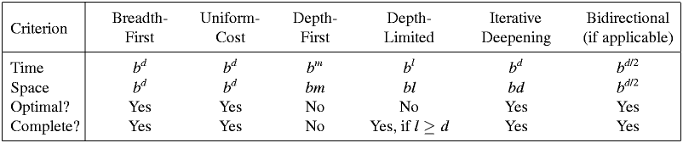
Summary of algorithms
CMPT 310 - Blind Search

Slide 53

Repeated states
Failure to detect repeated states can turn a linear problem into an exponential one!
CMPT 310 - Blind Search

Slide 54

Graph search
Simple solution: just keep track of which states you have visited.
Usually easy to implement in modern computers.
CMPT 310 - Blind Search

Slide 55
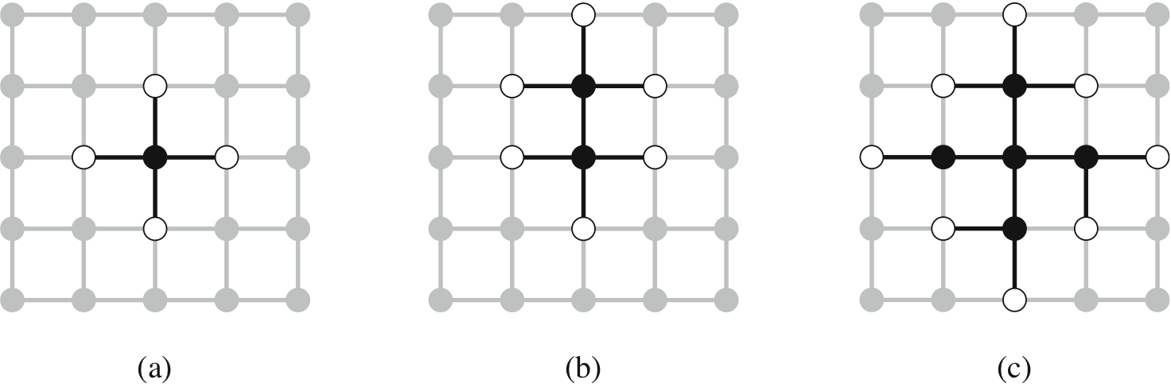
The Separation Property of Graph Search
Black: expanded nodes.
White: frontier nodes.
Grey: unexplored nodes.
CMPT 310 - Blind Search

Slide 56
Summary
Problem formulation usually requires abstracting away real-world details to define a state space that can feasibly be explored
Variety of uninformed search strategies
Iterative deepening search uses only linear space and not much more time than other uninformed algorithms
CMPT 310 - Blind Search

